Slide 1


Bootstrap
THE RESPONSIVE
UI LIBRARY

Slide 2
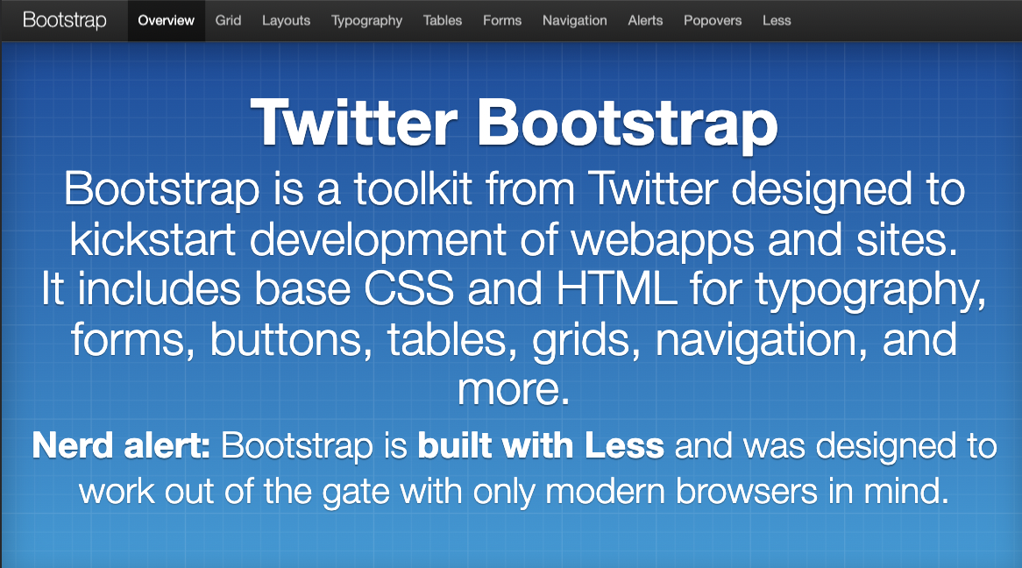
The Origins of Bootstrap
Built in 2011 as “Twitter Blueprint” by Twitter devs, to serve as an internal development tool to enforce design consistency for future UI of the platform
Launched officially as an open-source project later that year as “Twitter Bootstrap” - after a series of Hackathons developed it to Version 1.0
Now up to Version 5.0+, this version & prior Version 4.0 saw the biggest leaps, where its internal code was significantly altered to modernise the UI framework into the future

Slide 3


The “Whats” of Bootstrap
What is a “Component Library/UI Kit”?
A collection of pre-designed & pre-built UI elements, such as designed buttons, content-boxes, navigational features and other visual elements
What is a “responsive framework”?
A CSS framework built with a mobile-first & accessibility approach to enable building websites that works well across all browsers & devices
How is Bootstrap both of these things?
Bootstrap has embedded at its core, a philosophy of mobile-first for each component through use of grid, media queries & utilities
Makes sense, as its first-use platform was Twitter – which is typically consumed via mobile

Slide 4
Core Uses of Bootstrap
Pre-made Components
Quick & easy import of ready-made UI components
The UI components have a consistent, clean design with all necessary functionality
Responsive UI
Use of Bootstrap components instantly makes webapp responsive to multiple common device breakpoints & browsers
Class-based Utilities
Bootstrap can be minimally-used, by using its utilities which allow for easy additions of box model properties like padding, margins, flexbox & grid
Interactive UI
Many components are highly interactive / dynamic
Typically – these require HTML, CSS & JavaScript work to build on your own = covers knowledge gaps!

Slide 5

The Main Draw of Bootstrap
Bootstrap is still KING due to ease of use
Low barriers to using – for those learning HTML & CSS
Small but steep initial learning curve – which are often dealt with after completing 1 or 2 Bootstrap projects
It has excellent & clear documentation – especially the “components” section
Components come in-built with accessible/mobile-rich markup & styling = can ignore these aspects until ready

Slide 6




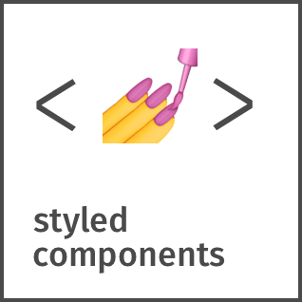










CSS Framework Landscape in ‘24
CSS3
Native Standard
Style Systems
CSS ++
Behaviour Libraries

Slide 7
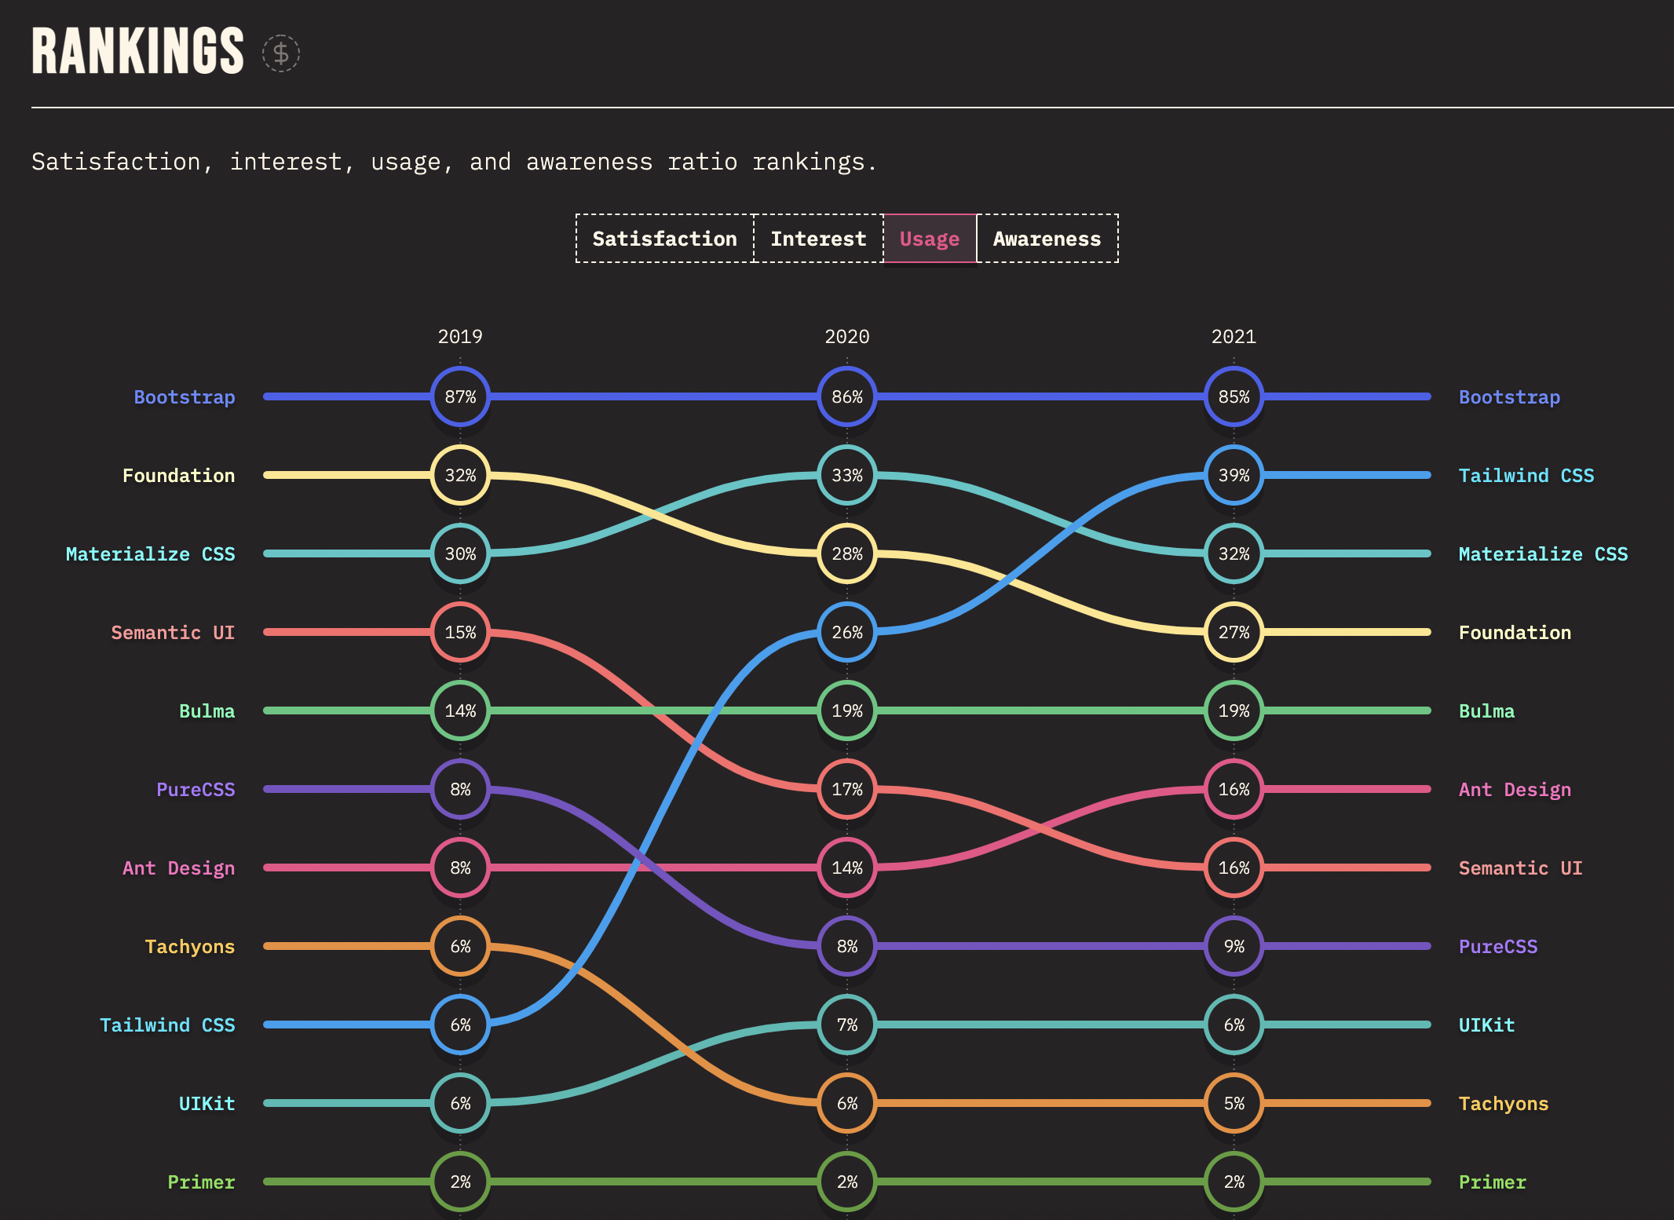
Responsive Frameworks &
UI Libraries:
Usage

Slide 8
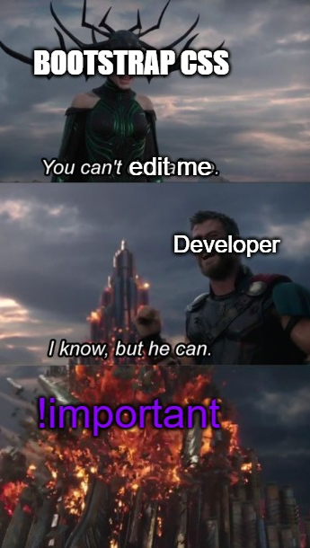
Dev Struggles with Bootstrap
1. Customised Styling rigidity
Bootstrap is known as an opinionated framework
“Opinionation” typically means the chosen framework has made more decisions for you, and is stubborn in those choices
Developers have been dissatisfied with Bootstrap, with difficulties in overwriting its default styling
Example: Most of Bootstrap classes are declared at class level, but often, has layered “!important” values in parts of its stylesheet which prevents higher specificity declarations replacing these styles
2. UI Monotony
Bootstrap is one of the most common UI frameworks between new devs & industry
Owing to this success + opinionation – websites built with default Bootstrap have become quite common
Led to a phenomenon where Bootstrap—designed often look very similar to each other = feels quite bland (aka “Bootstrappy websites”)

Slide 9
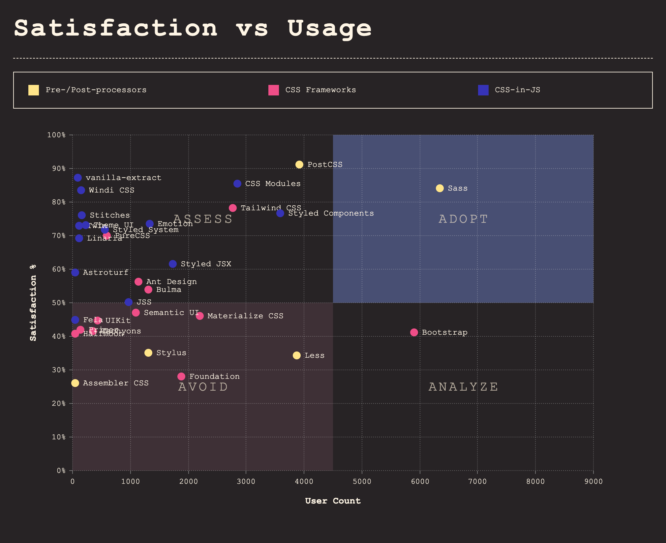

CSS General Trends

Slide 10
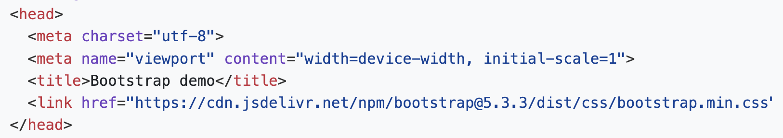
Bootstrap Integration
Open “Get Started” documentation in Browser
Ensure you are using the latest version
Insert the stylesheet link (via CDN) into the <head>
Insert the script (for interactive UI) at bottom of the <body>

Slide 11
Bootstrap Components List
Accordion
Alerts
Badge
Breadcrumb
Buttons
Card
Carousel
Collapse
Form elements
List groups
Modal
Navbar
Offcanvas
Pagination
Placeholders
Popovers
Progress / Spinners
Scrollspy
Tables
Toasts
Tooltips

Slide 12
Bootstrap Class Utilities List
Background colours (bg-#)
Borders (border-#)
Colours (text-#)
Display (d-#)
Flex (flex-#)
Interactions (pe-#)
Margin (m#-#)
Padding (p#-#)
Object fit (object-fit-#)
Opacity (opacity-#)
Overflow (overflow-#)
Position (position-#)
Shadows (shadow-#)
Sizing (w-# / h-#)
Text align (text-#)
Vertical align (align-#)
Visibility (visible / invisible)
Z-index (z-#)

Slide 13
Bootstrap Workshop

Slide 14
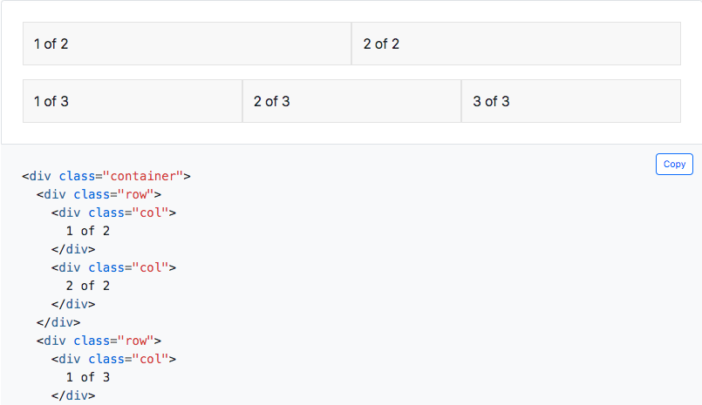
Recap – Grid System & Bootstrap
Bootstrap Grid System allows users to create responsive layouts
Use it to rearrange the layout of the website depending on its’ screen size
Example: Using Bootstrap Grid, we can create a page which will have different layouts on a desktop and a mobile.
The key to this are the classes:
.container
.row
.col

Slide 15
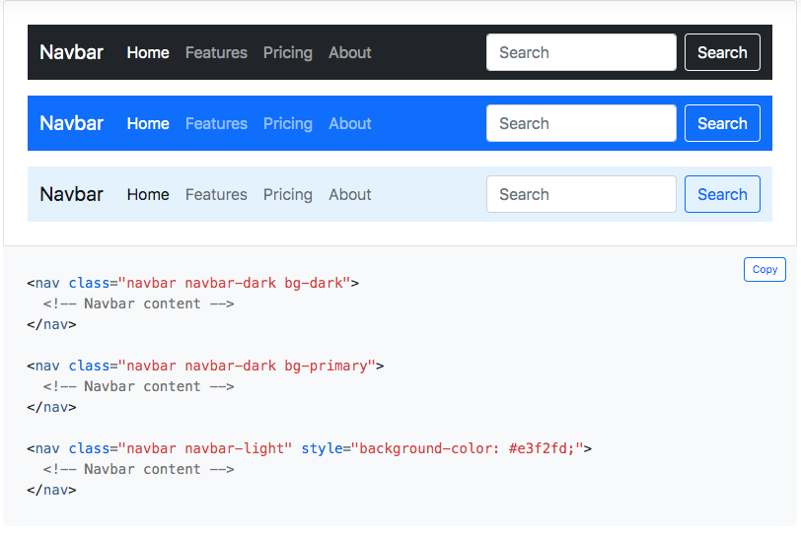
Component 1: navbar & nav
Purpose: To create our main, powerful and responsive navigation header (as well as footers)
Documentation:
Navbar
Nav
Also useful - container

Slide 16
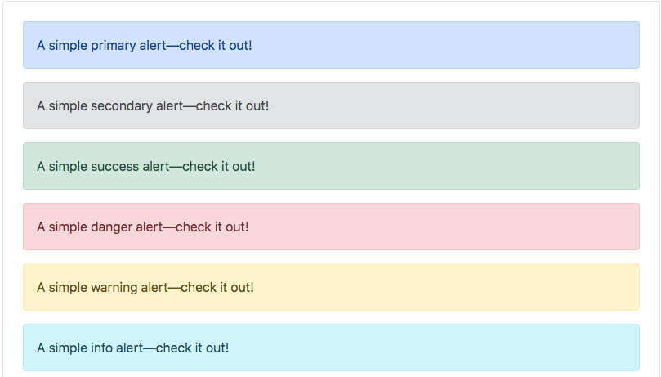
Component 2: alert, badge & button
Purpose: Features which are integral to user interaction, request initiation & feedback systems in the event of success or failure
Documentation:
Alerts
Badges
Buttons

Slide 17
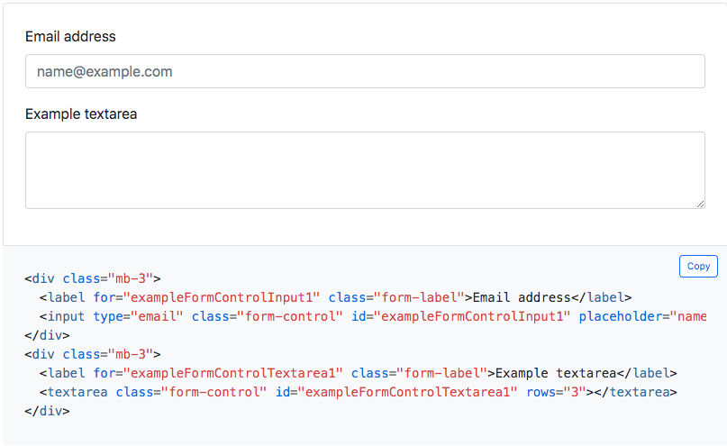
Component 3: form elements
Purpose: To allow for the easy creation of responsive forms (and tables), with plenty of styling features, form inputs and display options
Documentation:
Form element
Form inputs
Input groups (and plenty more)
Also useful - tables

Slide 18
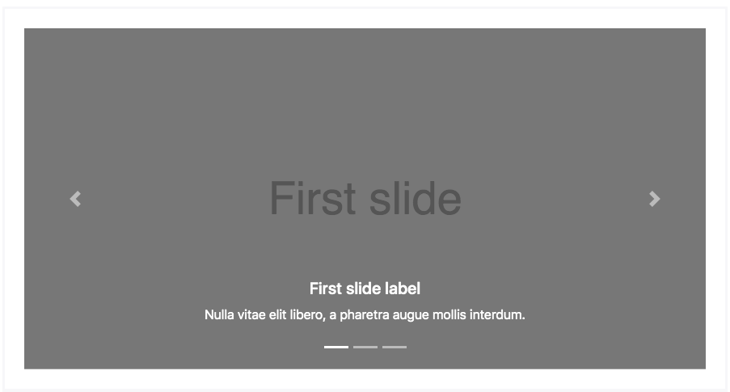
Component 4: carousel
Purpose: An element for cycling through images, or in the case of Jumbotron, an element for displaying static ”hero images” with floated text
Documentation:
Carousel
Was useful – Jumbotron (deprecated)

Slide 19
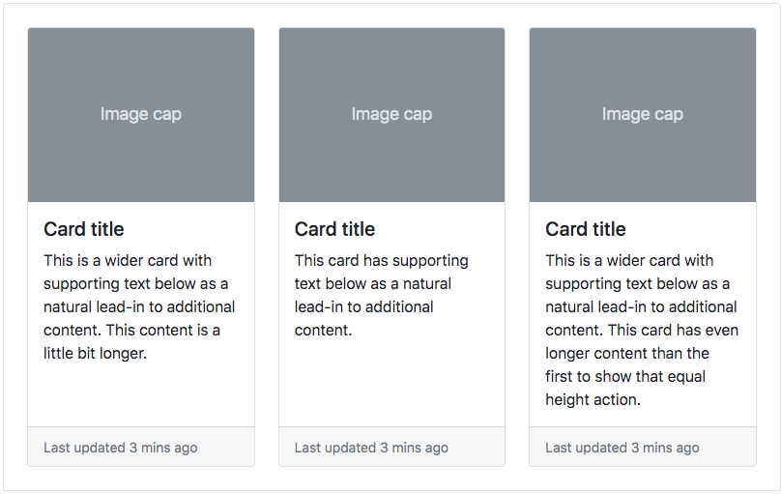
Component 5: card
Purpose: A clean and flexible content container with a large array of design options & list display choices.
Documentation:
Card

Slide 20
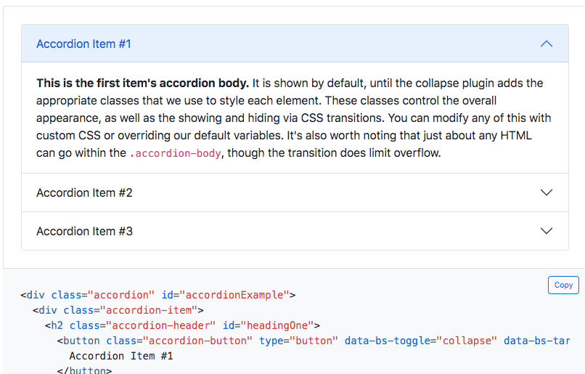
Component 6: accordion (not used)
Purpose: Vertical collapsing containers for content – which uses a Javascript plugin to function
Documentation:
Accordion

Slide 21

Practical Bootstrap Workshop
Main purpose of the slides is to provide a HELPFUL REFERENCE GUIDE
May help if you are looking for some go to Bootstrap Components for your project
HOWEVER - the best way to learn Bootstrap, is to use it!
We will do a quick demonstration and then into the “BurgerLab” challenges!

